Slide 1

Predicting customer buying behavior

Slide 2
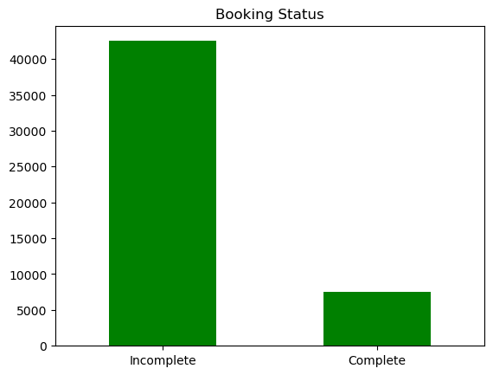
predictive model to understand factors that influence buying behavior
We have trained the data set with Random forest classifier model and Logistic Regression and received
Accuracy for Logistic Regression : 0.84864
Accuracy for Random Forest : 0.83808
flight_duration
wants_extra_baggage
length_of_stay
Num_passengers
are the top 4 features which influence Customer buying
behavior
We need to make sure the booking process is easier and more understandable for everyone, so that the incomplete status for the booking decreases

